Slide 1
Team Odyssey

Slide 2
Team Odyssey
BSGD Douglas Buzzell, Producer
BSGD Kevin Giang*, Tech Lead
GAM 302
* Speech requirement

Slide 3
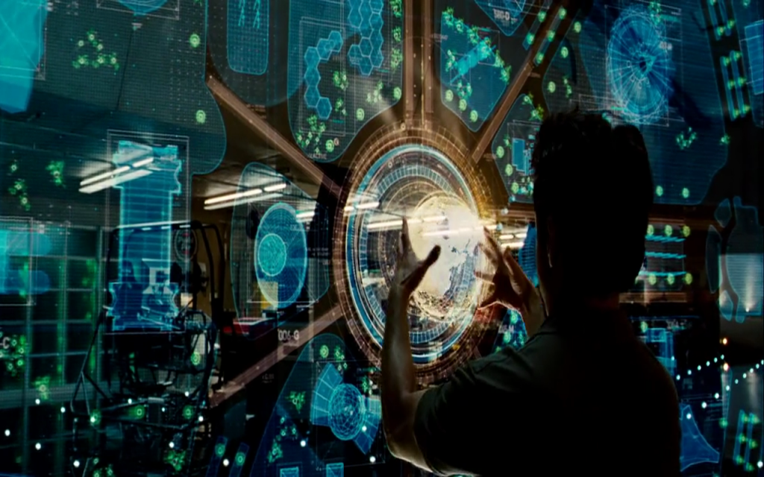
High Concept
Virtual Reality Adventure Game
Uses the Oculus Rift and Razer Hydra
PUSH & PULL as core mechanic
Solving environmental puzzles

Slide 4
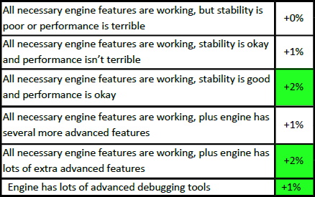
Engine

Slide 5
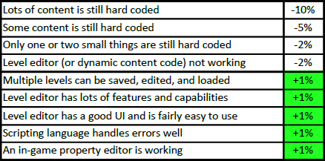
Pipeline

Slide 6
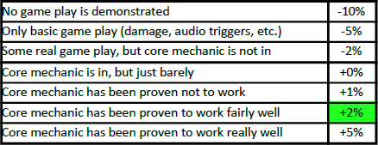
Game Play

Slide 7
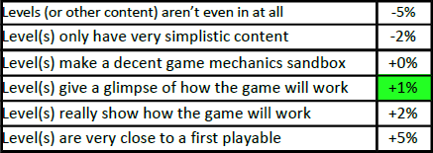
Content

Slide 8
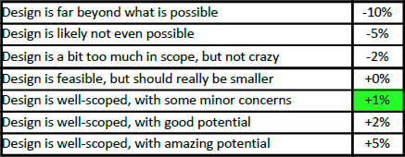
Scope

Slide 9
Demo
Presenting . . .
1st PUSH!

Slide 10
Playtesting
Feedback
Updates to Player Controller
Changed Calibration
Simulation Sickness Issues
Positive Response to Hardware

Slide 11
Deliverables
Three Levels (minimum)
UI / HUD

Slide 12
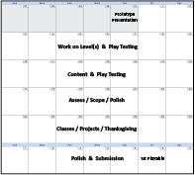
Schedule
Week 9: Level(s) & Playtesting
Week 10: Content & Playtesting
Week 11: Assess / Scope / Polish
Week 12: Classes / Projects / Thanksgiving
Week 13: Polish & Submission

Slide 13
Risk and Mitigations
Finding Unique Game Concept (2)
Add Developers
Find a UDK Developer
Deadlines

Slide 14
Risk and Mitigations
Art and Animations (4)
Derelict Art Assets
Add Artists to Team
Use Abstract Art

Slide 15
Risk and Mitigations
Time (7)
Planning & Scheduling
Add Team Members

Slide 16
Risk and Mitigations
Hardware Failure (10)
Replacement (time & cost)
Proper Instructions & Use
Add Strap to Controllers
Don't Use the Hardware

Slide 17
Risk and Mitigation
Hardware Failure (10)
  Replacement. (time & cost)
  Proper Instruction for Use
  Add Strap to Hydra
  Don't Use It.

Slide 18
Odyssey
1st Push!

